Slide 1
Mystique Java Implementation Introduction (Data Structure)
Beam Liu

Slide 2
Agenda
Namespace
Type
Property
Method
Anvil Script

Slide 3

Namespace
WCF3 module is a namespace
All the WCF artifacts should be under namespace
Namespace is a tree, split with “.”
Root namespace is com.quest.forge.ui.core.data. StandardType.ROOT
Two instances: SimpleNamespace & PersistentNamespace
Sample code to retrieve all namespaces
Notes:
Some special namespace: forge.lang, forge.data, forge.units, forge.definitions, forge.ui, forge.ide
SimpleNamespace: defined those base definitions that make wcf itself runable
PersistentNamespace: other artfacts, such as IDE, user defined views/types…

Slide 4
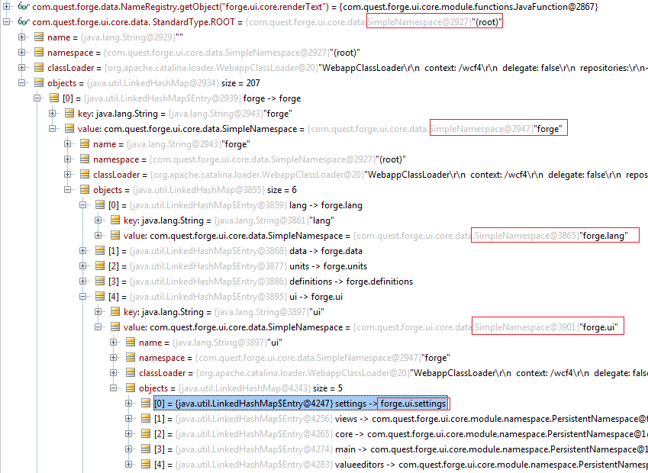
Namespace

Slide 5

Type
StandardType
  Necessary types that make wcf runable
  Atomic type (forge.lang.Void, forge.lang.Double, forge.lang.TimeRange…)
  Defined constants com.quest.forge.ui.core.data.StandardType.XXX
EditableType
  A complex constructed type
  Usually, it has attributes, even methods and instance-class
  ViewDefinition also extends from EditableType
Sample code to search definitions
Notes:
A EditableType sample:
<type name="IndexKey" extends="Writable">
<set property="abstract"/>
</type>
<type name="IndexParameterReference" extends="IndexKey"
instance-class="com.quest.forge.ui.core.module.index.IndexParameterReference">
<property name="name" type="String"/>
</type>

Slide 6
Property
Property in EditableType
StandardProperty
  Most of properties are standard property
  valueType, some possible instance: EditableType(sample:SizingOption), StandardType(sample: Enum), ConstructedType(Function<Tuple<N>, List<N>>)
ConstructedProperty
  Properties with parameter
  Some of EditableType contains ConstructedProperty
    forge.data.Metric
    forge.monitoring.TopologyObjectObservation
    forge.monitoring.EnumObservation
    forge.monitoring.ComplexObservation
    forge.monitoring.CatalystTransientMetric
    forge.ui.views.chart.MetricAxisData

Slide 7
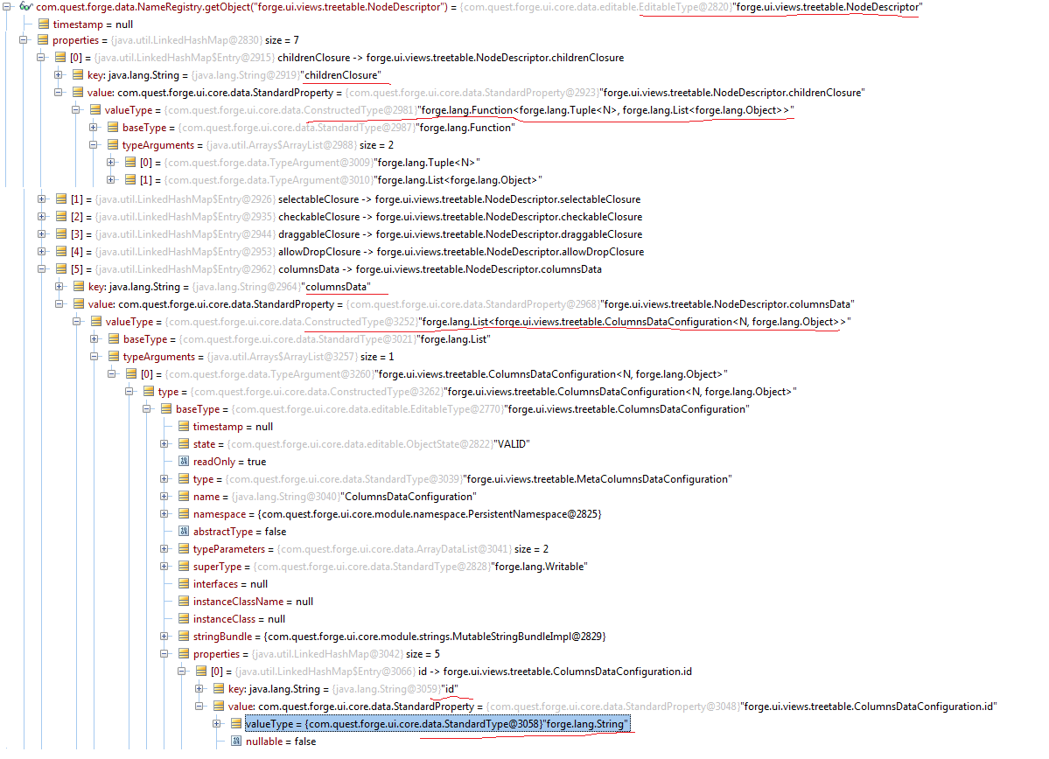
Property (forge.ui.views.treetable.NodeDescriptor)

Slide 8
Method
Method in EditableType
StandardMethod
  Sample: forge.UI.core.TreeTable.createCellView
ConstructedMethod
  Sample:
  forge.definitions.CodeFunction
  forge.definitions.JavaFunction
  forge.definitions.GroovyFunction

Slide 9
Anvil Script
Syntax is similar as Groovy
Interpreted language base on beaver open source
Resolver is written by WCF team
More Anvil script grammar, refer to testcase
  wcf-framework/core4/test/java/com.quest.forge.ui.core.lang.compiler

Slide 10
OO design in dashboard development
Dashboard design
  Split a large dashboard into different several widgets
  One widget usually contains at least one feature
  One widget usually contains some properties to store data
  One widget usually contains some events to define actions
  Reduce coupling between widgets
  Emit events to trigger action from inside to outside
  Update property value to trigger action from outside to inside

Slide 11

Q&A
And Thank You! ☺

